Slide 1
Documentation Generation:
Final Report
CSCI 2340
Dev Bhatia <dev_bhatia@brown.edu>, Abubakarr Jaye <abubakarr_jaye@brown.edu>, Riley Li <qiwen_li@brown.edu>, Sudham Hebbar <sudham_hebbar@brown.edu>, Yanan Song <yanan_song@brown.edu>, Yixin Deng <yixin_deng@brown.edu>, Yueqi Mao <yueqi_mao@brown.edu>, Helen Du <zhonghui_du@brown.edu>

Slide 2
Project Overview

Slide 3
Problem Statement
Documentation is difficult to write and keep up to date.
The goal of this project is to provide developers a more reasonable initial set of documentation using LLMs and other tools.

Slide 4
Selected Requirements
Input Sources:
The app should support various input sources, including source code files, comments, and documentation tags within the code.
Language Support:
The app must be able to parse and generate documentation for multiple programming languages.
Customization:
Users should be able to customize the documentation output by manually editing the output in confluence.
Version Control Integration:
Integration with version control systems (e.g., Git) to track changes and update documentation accordingly.

Slide 5
Selected Requirements
Different approaches were viable
Not Yet Integrated
Input Sources:
The app should support various input sources, including source code files, comments, and documentation tags within the code.
Language Support:
The app must be able to parse and generate documentation for multiple programming languages.
Customization:
Users should be able to customize the documentation output by manually editing the output in confluence.
Version Control Integration:
Integration with version control systems (e.g., Git) to track changes and update documentation accordingly.

Slide 6
Selected Requirements
Confluence-Only Approach
Fully Integrated
Input Sources:
The app should support various input sources, including source code files, comments, and documentation tags within the code.
Language Support:
The app must be able to parse and generate documentation for multiple programming languages.
Customization:
Users should be able to customize the documentation output by manually editing the output in confluence.
Version Control Integration:
Integration with version control systems (e.g., Git) to track changes and update documentation accordingly.

Slide 7
Selected Specifications
User Interface
The initial implementation of our project will be a web app that, when provided with a github link, generates a confluence page describing what the app does based on classes/methods within.
Output Structure
The confluence pages shall follow the same file structure as the source code and shall have a one to one mapping. Each page shall describe the source code at the functional level, ensuring that the source code is covered to an acceptable level.
Manual Editing
When the confluence page is displayed to the user, they will have the ability to manually update text within the Confluence webapp.
Use of the LLM
The Retrieval-Augmented Generation (RAG) approach enhances Large Language Models (LLMs) by integrating a step to fetch new data based on user inputs, thus improving response accuracy. This process involves collecting new information from diverse sources (a code base in our use case) and converting it into a format the LLM can search.
Automated Updating
As far as updating goes, we will integrate Github Actions with our implementation such that a push to main in a hypothetical target repository would trigger a regeneration of the confluence page. This will ensure that the documentation remains up to date

Slide 8
Selected Specifications
Different approaches were viable
Not Yet Integrated
User Interface
The initial implementation of our project will be a web app that, when provided with a github link, generates a confluence page describing what the app does based on classes/methods within.
Output Structure
The confluence pages shall follow the same file structure as the source code and shall have a one to one mapping. Each page shall describe the source code at the functional level, ensuring that the source code is covered to an acceptable level.
Manual Editing
When the confluence page is displayed to the user, they will have the ability to manually update text within the Confluence webapp.
Use of the LLM
The Retrieval-Augmented Generation (RAG) approach enhances Large Language Models (LLMs) by integrating a step to fetch new data based on user inputs, thus improving response accuracy. This process involves collecting new information from diverse sources (a code base in our use case) and converting it into a format the LLM can search.
Automated Updating
As far as updating goes, we will integrate Github Actions with our implementation such that a push to main in a hypothetical target repository would trigger a regeneration of the confluence page. This will ensure that the documentation remains up to date

Slide 9
Selected Specifications
Confluence-Only Approach
Fully Integrated
User Interface
The initial implementation of our project will be a web app that, when provided with a github link, generates a confluence page describing what the app does based on classes/methods within.
Output Structure
The confluence pages shall follow the same file structure as the source code and shall have a one to one mapping. Each page shall describe the source code at the functional level, ensuring that the source code is covered to an acceptable level.
Manual Editing
When the confluence page is displayed to the user, they will have the ability to manually update text within the Confluence webapp.
Use of the LLM
The Retrieval-Augmented Generation (RAG) approach enhances Large Language Models (LLMs) by integrating a step to fetch new data based on user inputs, thus improving response accuracy. This process involves collecting new information from diverse sources (a code base in our use case) and converting it into a format the LLM can search.
Automated Updating
As far as updating goes, we will integrate Github Actions with our implementation such that a push to main in a hypothetical target repository would trigger a regeneration of the confluence page. This will ensure that the documentation remains up to date

Slide 10
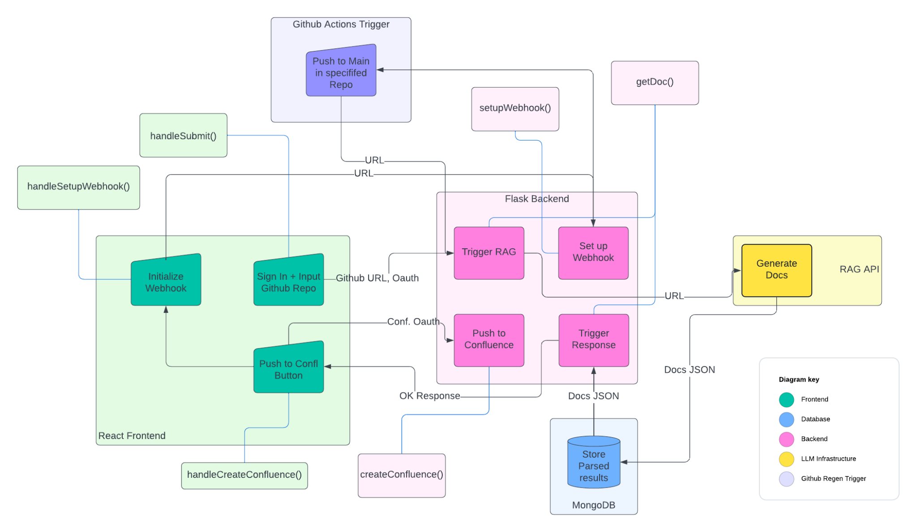
Final Architecture

Slide 11
Demo!

Slide 12
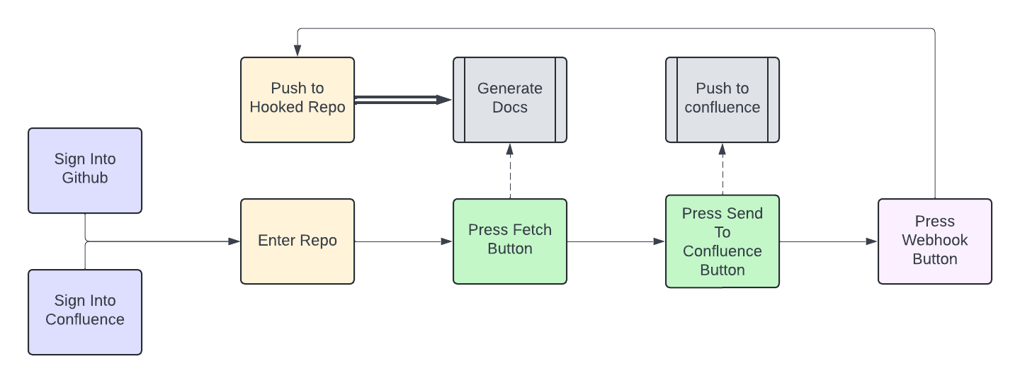
What We Implemented

Slide 13
What we Accomplished Lately
Huge Bug Fixes!
Multiple submissions work as intended, logging levels
Automated Documentation Regeneration
Integrated with the rest of the application
Testing Suite
Independent tests for the frontend and backend
Basic Penetration Testing
No SQL Injections here!
Confluence OAuth Integration
Removes need for API
Better Documentation
Both within the code and outside

Slide 14
Possible Next Steps
More Bug Fixes
Wider Scope of Languages
Currently Feature Support for Python, Java, and Javascript
Give option for full-cycle
May clog up documentation
Better Status Messages
A bit nondescript right now
Codebase Cleanup
Some dead code still floating around
Large-scale User Testing
Still unsure how our application will respond to more users
Hosting and Deploying
This could be something useful for organizations as a whole

Slide 15
Questions?

